Slide 1
Personality theories
Lecture - 24

Slide 2
content
Psychological theory
Social-psychological theory
Trait theory
Holistic theory

Slide 3
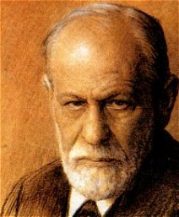
Psychological theory
Sigmund Freud
Medical school graduate
Specialized in nervous disorders
Freud’s three levels of awareness/ consciousness:
the conscious mind,
the Subconscious mind, and
the unconscious mind

Slide 4
Psychological theory
Conscious
Thoughts or motives that a person is currently aware of
Subconscious
Thoughts or motives blocked from normal awareness. Contains information that can be viewed with little extra effort
Unconscious
Thoughts or motives that a person is not aware of

Slide 5
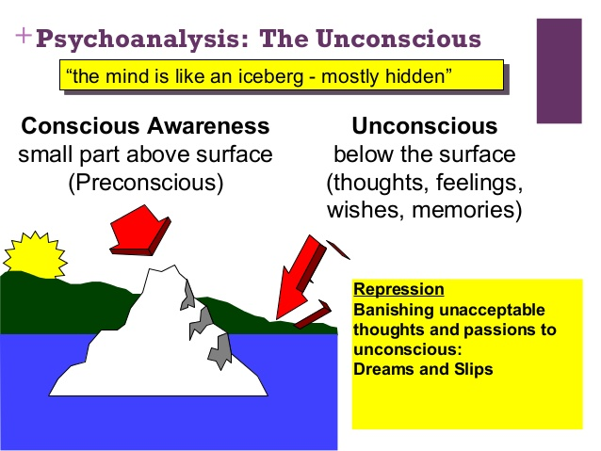

Slide 6
Psychological theory
Unconsciousness framework motivates man to act in a particular way
Contains three interrelated aspects:
The Id:
unconscious part of human that seeks satisfaction of biological need such as hunger, thirst, etc
Throughout life person act in a specific manner
Humans tries to remove tension by satisfying biological needs through forming a metal image of that object

Slide 7
Psychological theory
The Ego:
Self-centric explanation related to ‘I’, ‘My’, or ‘self’
Conscious or logical part of human personality based on reality
Super Ego:
Based on personal and social values, norms and ethics.
Judges the behaviour or action as right or wrong in relation to given situation
Consists of conscious and the ego-ideal
Ideal/desirable response to the stimuli

Slide 8
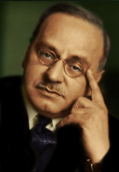
Social-Psychological theory
Alfred Adler was an Austrian medical doctor, psychotherapist, and founder of the school of individual psychology
States that psychological characteristics of a person are effected by social environment
Individual and society cannot exist in isolation

Slide 9
Social-Psychological theory
Theory emphasises on following social aspects that shapes one’s personality:
Building social relations
Making socially relevant work
Viewing people positively
Developing positive attitude
Career planning and networking
Balancing between work and life
Developing interpersonal skills

Slide 10
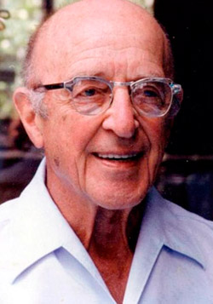
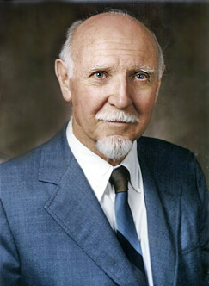
trait theory
Gordon Allport was an American psychologist
Raymond Bernard Cattell was a British American psychologist
Traits are basic characteristics or qualities of people

Slide 11
trait theory
Allport identified six personality traits:
Religious traits or values
Social values
Economic values
Political values
Aesthetic values
Theoretical values

Slide 12
trait theory
Cattell developed same types of traits, but he classified them into two groups:
Surface traits
Wise-foolish, affectionate-cold, honest-dishonest, etc
Source traits
Maturity, good nature, trustworthiness, etc
Individual hide their feelings (i.e., source traits) and exhibit desirable traits (i.e., surface traits)

Slide 13
holistic theory
Treats individual as a whole
Also known as self theory
Based on self concept
Given by Carl Roger, Abraham Maslow, Frederic Herzberg and Lewin

Slide 14
holistic theory
Theory consists of four factor related to self-concept:
Self-image:
How a person believes about himself
Ideal Self:
Shows an ideal or expected conduct.
Shows the way one likes to be

Slide 15
holistic theory
Looking Glass-Self:
Belief of a person about how others perceive his characteristics and qualities
Real Life:
It shows what one actually is
Indicates real characteristics, values and attitudes

